Slide 1
ROAD MAINTENANCE FORUM 07 April 2022
Presented by
Johan Hattingh

Slide 2
BASE LAYER MATERIAL FOR PATCHING
Introduction: (Pothole patching as “self-imposed KPI”; Basic pavement management principles must be in-place)
Basic Principles prior to Patching
Understand or determine mechanism of failure (deformation, binder properties, raveling, crack activity, pumping and poor drainage)
Design the patch in accordance with the findings of 2i) regarding thickness of repair, follow-up activity, choice of patching materials, related activities, reinstatement of drainage etc.

Slide 3
BASE LAYER MATERIAL FOR PATCHING
Choice of Materials for Patching
Basic Principle: Material to be compatible with existing pavement
Granular base with granular material of similar properties
Macadam base with macadam material
Cemented base with cemented material
Emergency patching: asphaltic materials (refer to Herman Marias’s presentation)

Slide 4
BASE LAYER MATERIAL FOR PATCHING
Basic Construction Techniques
Limit the depth of sawcut joint to 5mm (Rather, do not use diamond cutting blades)
Avoid jointing in wheel tracks
Consider final level of patch with next activity
Avoid vertical excavation walls (rather step or incline)
Avoid “dam wall” formation (reservoir effect)

Slide 5
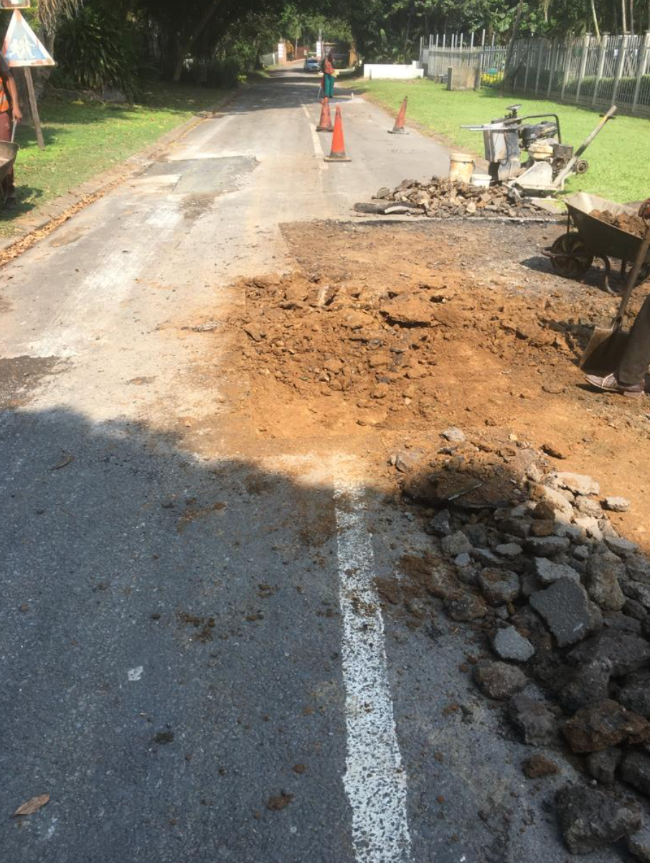
BASE LAYER MATERIAL FOR PATCHING
Example of well-intended, but poorly executed pothole patching
Incorrect choice of base material & poor joint placement

Slide 6
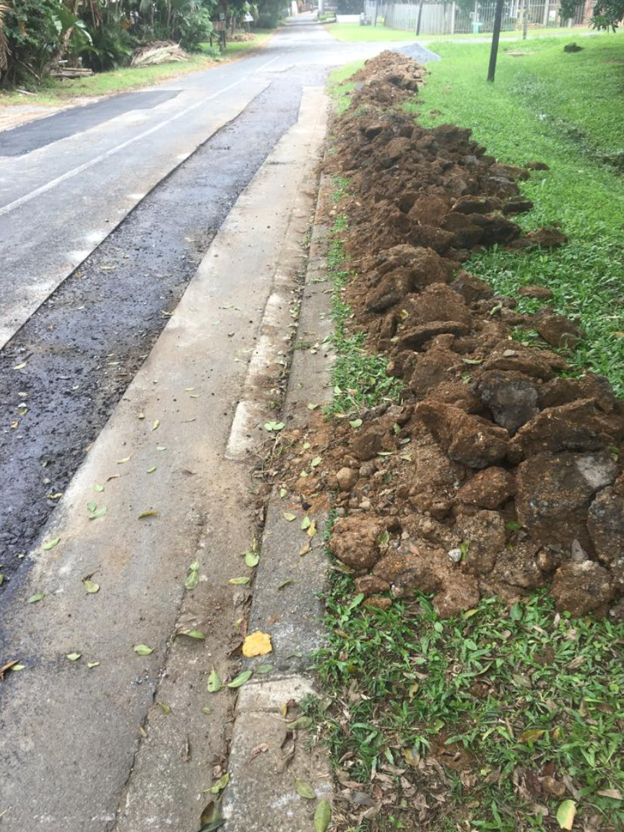
BASE LAYER MATERIAL FOR PATCHING
Example of well-intended, but poorly executed pothole patching
Incorrect choice of base material & poor joint placement

Slide 7
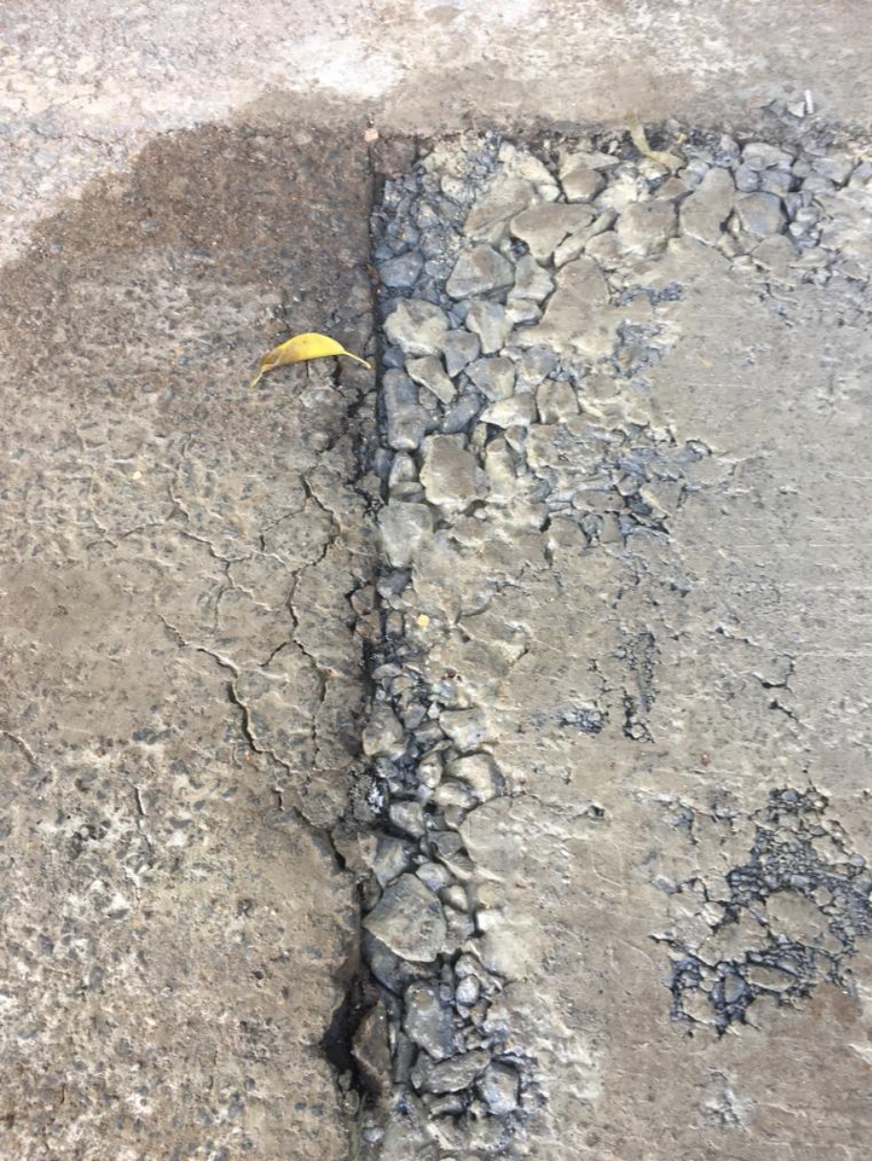
BASE LAYER MATERIAL FOR PATCHING
Recent examples of well-intended, but poorly executed pothole patching
Segregation of G1 aggregate

